Slide 1
ESBM 4570 Company Formation and IP Protection
Professor Burnes
Leeds School of Business
University of Colorado Boulder
Leeds
B U S I N E S S
Page 1

Slide 2
Company Structure
Why is it Important
What are your choices?
Where should you make investments/use CASH – for different structures/business goals
Where can/should you use SAVE CASH for different structures/business goals?

Slide 3
Concepts to Keep in Mind
Risk
Costs
Growth
Access to Capital
Exit

Slide 4
By the numbers
Formation Type | Number in US (2020-2023) | Employment
Sole Proprietorships | ~28.4M | ~ 28.4M*
LLCs | ~ 21.6 M | ~ 32M
SCorps | ~ 5M | NA
C Corps | ~1.7M | ~ 55M
Publicly Traded (must be C Corp) | ~6300
Note these may double count employment because people can have
“sole proprietorship” on the side

Slide 5
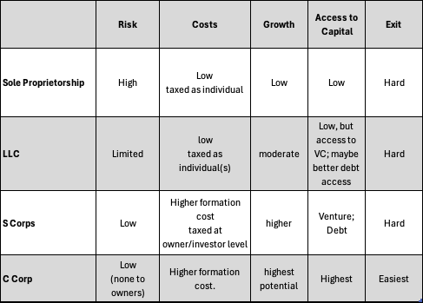
Let’s Take a High Level Look at Formation Structures
**Please see Figure 3.2 in Book, it is a good summary

Slide 6
B Corps
This is a certification and a demonstration of values, NOT a recognized legal formation.
Bcorps*
Demonstrate high social and environmental performance by achieving a B Impact Assessment score of 80 or above and passing our risk review. Multinational corporations must also meet baseline requirement standards.
Make a legal commitment by changing their corporate governance structure to be accountable to all stakeholders, not just shareholders, and achieve benefit corporation status if available in their jurisdiction.
Exhibit transparency by allowing information about their performance measured against B Lab’s standards to be publicly available on their B Corp profile on B Lab’s website.
*source BCorps

Slide 7
Public Benefit Corporations
Moves from Shareholder Value maximization to including Stakeholders and/or Specific public benefit in Charter.
You must choose your Corporate Formation and THEN you may choose PBC – identify a public benefit purpose.
There are still reporting requirements. This puts level of accountability/transparency in place.
Examples of PBCs

Slide 8
Non Profit
Non Profits are “501c3
This is a TAX STATUS, not a profit mandate
Non Profits do NOT pay taxes on income
AND, there is generally favorable tax treatment for ‘donors’
High reporting requirements
Annual audit

Slide 9
IP Protection

Slide 10
Why talk about IP protection
Intellectual Property (IP) is one of the “moats” that a company develops to protect its market space.

Slide 11
CAN
Patents
Trade secrets
Trademarks
Copyrights
SHOULD YOU?

Slide 12
Patent
Yes. Can protect IP.
Expensive.
Takes time and money.
Time limited in protection.
Protection is on you.
**Be careful where patent held/by whom in organization.
For reference –
There are ~ 114 million patent records
Since 2015, there have been ~6 million applications filed

Slide 13
Trade Secret
Heinz Tomato Ketchup
Dr Pepper
CONFIDENTIAL INFORMATION, for which you must demonstrate that you have put effort into protecting.
Low cost to file, costs are for protection and enforcement.

Slide 14
Trademark
Filing less expensive (~$600-$800), unless you need legal assistance
Costs come from monitoring, protection and renewal

Slide 15
Next week:
The case is Financing Operations and Growth
The majority of our time will be spent on the path and choices made by Amalgamated Furniture and eBay in their business formation and development.
Focus on Cash, Business Formation, and Operational Priorities
Following the discussion, we will continue with Chapter 5, evaluating operational and financial performance.

